Slide 1
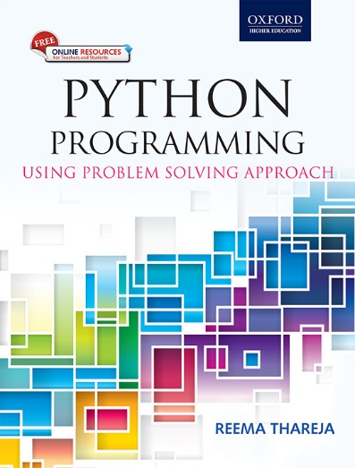
1
Python Programming
Using Problem Solving Approach
Reema Thareja

Slide 2
CHAPTER 7
File Handling
© Oxford University Press 2017. All rights reserved.

Slide 3
File
A file is a collection of data stored on a secondary storage device like hard disk.
A file is basically used because real-life applications involve large amounts of data and in such situations the console oriented I/O operations pose two major problems:
• First, it becomes cumbersome and time consuming to handle huge amount of data through terminals.
• Second, when doing I/O using terminal, the entire data is lost when either the program is terminated or computer is turned off. Therefore, it becomes necessary to store data on a permanent storage (the disks) and read whenever necessary, without destroying the data.
© Oxford University Press 2017. All rights reserved.

Slide 4
File Path
Files that we use are stored on a storage medium like the hard disk in such a way that they can be easily retrieved as and when required.
Every file is identified by its path that begins from the root node or the root folder. In Windows, C:\ (also known as C drive) is the root folder but you can also have a path that starts from other drives like D:\, E:\, etc. The file path is also known as pathname.
Relative Path and Absolute Path
A file path can be either relative or absolute. While an absolute path always contains the root and the complete directory list to specify the exact location the file, relative path needs to be combined with another path in order to access a file. It starts with respect to the current working directory and therefore lacks the leading slashes. For example, C:\Students\Under Graduate\BTech_CS.docx but Under Graduate\BTech_CS.docx is a relative path as only a part of the complete path is specified.
© Oxford University Press 2017. All rights reserved.

Slide 5
ASCII Text Files
A text file is a stream of characters that can be sequentially processed by a computer in forward direction. For this reason a text file is usually opened for only one kind of operation (reading, writing, or appending) at any given time. Because text files can process characters, they can only read or write data one character at a time. In Python, a text stream is treated as a special kind of file.
Depending on the requirements of the operating system and on the operation that has to be performed (read/write operation) on the file, the newline characters may be converted to or from carriage-return/linefeed combinations. Besides this, other character conversions may also be done to satisfy the storage requirements of the operating system. However, these conversions occur transparently to process a text file. In a text file, each line contains zero or more characters and ends with one or more characters
Another important thing is that when a text file is used, there are actually two representations of data- internal or external. For example, an integer value will be represented as a number that occupies 2 or 4 bytes of memory internally but externally the integer value will be represented as a string of characters representing its decimal or hexadecimal value.

Slide 6
Binary Files
A binary file is a file which may contain any type of data, encoded in binary form for computer storage and processing purposes. It includes files such as word processing documents, PDFs, images, spreadsheets, videos, zip files and other executable programs. Like a text file, a binary file is a collection of bytes. A binary file is also referred to as a character stream with following two essential differences.
• A binary file does not require any special processing of the data and each byte of data is transferred to or from the disk unprocessed.
• Python places no constructs on the file, and it may be read from, or written to, in any manner the programmer wants.
While text files can be processed sequentially, binary files, on the other hand, can be either processed sequentially or randomly depending on the needs of the application.

Slide 7
The Open() Function
Before reading from or writing to a file, you must first open it using Python’s built-in open() function. This function creates a file object, which will be used to invoke methods associated with it. The syntax of open() is:
fileObj = open(file_name [, access_mode])
Here,
file_name is a string value that specifies name of the file that you want to access.
access_mode indicates the mode in which the file has to be opened, i.e., read, write, append, etc.
Example:
© Oxford University Press 2017. All rights reserved.

Slide 8
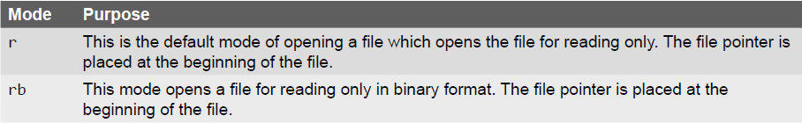
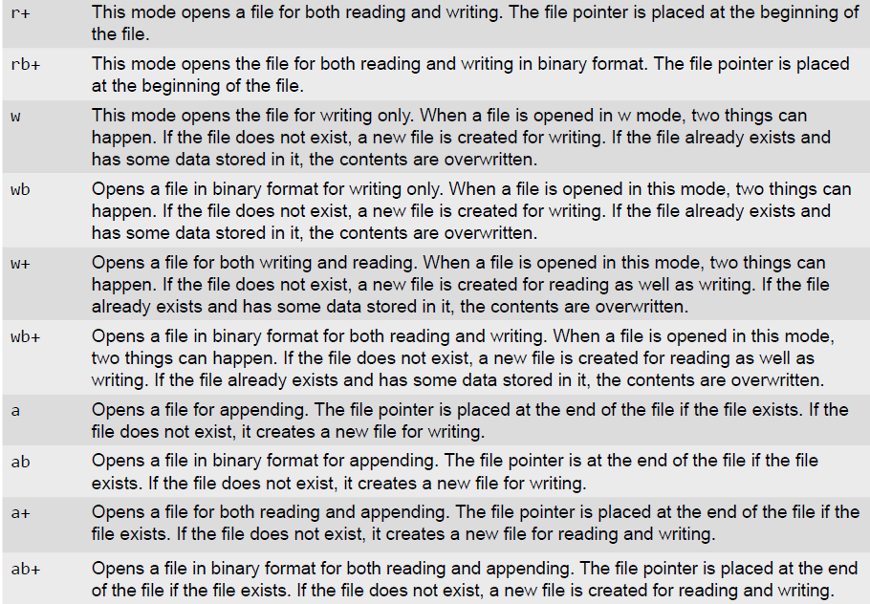
The open() Function – Access Modes
© Oxford University Press 2017. All rights reserved.

Slide 9
The File Object Attributes
Once a file is successfully opened, a file object is returned. Using this file object, you can easily access different type of information related to that file. This information can be obtained by reading values of specific attributes of the file.
Example:
© Oxford University Press 2017. All rights reserved.

Slide 10
The close () Method
The close() method is used to close the file object. Once a file object is closed, you cannot further read from or write into the file associated with the file object. While closing the file object the close() flushes any unwritten information. Although, Python automatically closes a file when the reference object of a file is reassigned to another file, but as a good programming habit you should always explicitly use the close() method to close a file. The syntax of close() is fileObj.close()
The close() method frees up any system resources such as file descriptors, file locks, etc. that are associated with the file. Moreover, there is an upper limit to the number of files a program can open. If that limit is exceeded then the program may even crash or work in unexpected manner. Thus, you can waste lots of memory if you keep many files open unnecessarily and also remember that open files always stand a chance of corruption and data loss.
Once the file is closed using the close() method, any attempt to use the file object will result in an error.
© Oxford University Press 2017. All rights reserved.

Slide 11
The write() and writelines() Methods
The write() method is used to write a string to an already opened file. Of course this string may include numbers, special characters or other symbols. While writing data to a file, you must remember that the write() method does not add a newline character ('\n') to the end of the string. The syntax of write() method is: fileObj.write(string)
The writelines() method is used to write a list of strings.
Examples:
© Oxford University Press 2017. All rights reserved.

Slide 12
append() Method
Once you have stored some data in a file, you can always open that file again to write more data or append data to it. To append a file, you must open it using 'a' or 'ab' mode depending on whether it is a text file or a binary file. Note that if you open a file in 'w' or 'wb' mode and then start writing data into it, then its existing contents would be overwritten. So always open the file in 'a' or 'ab' mode to add more data to existing data stored in the file.
Appending data is especially essential when creating a log of events or combining a large set of data into one file.
Example:
© Oxford University Press 2017. All rights reserved.

Slide 13
The read() and readline() Methods
The read() method is used to read a string from an already opened file. As said before, the string can include, alphabets, numbers, characters or other symbols. The syntax of read() method is fileObj.read([count])
In the above syntax, count is an optional parameter which if passed to the read() method specifies the number of bytes to be read from the opened file. The read() method starts reading from the beginning of the file and if count is missing or has a negative value then, it reads the entire contents of the file (i.e., till the end of file).
The readlines() method is used to read all the lines in the file
Example:
© Oxford University Press 2017. All rights reserved.

Slide 14
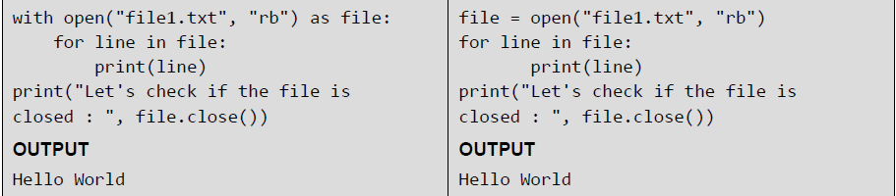
Opening Files using “with” Keyword
It is good programming habit to use the with keyword when working with file objects. This has the advantage that the file is properly closed after it is used even if an error occurs during read or write operation or even when you forget to explicitly close the file.
Examples:
© Oxford University Press 2017. All rights reserved.

Slide 15
Splitting Words
Python allows you to read line(s) from a file and splits the line (treated as a string) based on a character. By default, this character is space but you can even specify any other character to split words in the string.
Example:
© Oxford University Press 2017. All rights reserved.

Slide 16
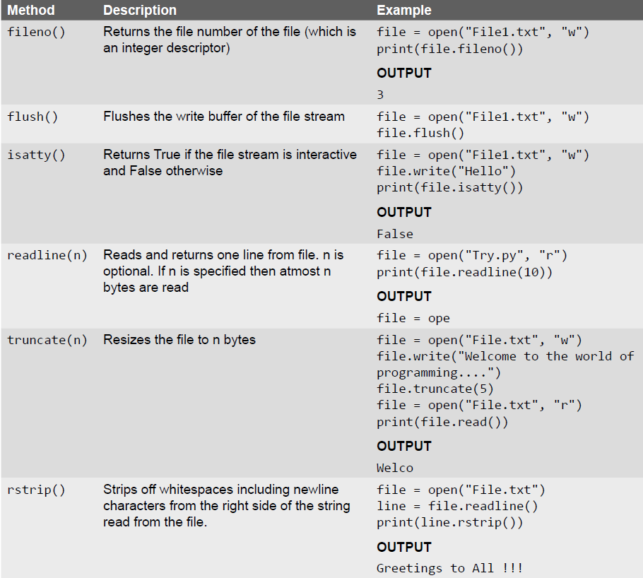
Some Other Useful File Methods
© Oxford University Press 2017. All rights reserved.

Slide 17
File Positions
With every file, the file management system associates a pointer often known as file pointer that facilitate the movement across the file for reading and/ or writing data. The file pointer specifies a location from where the current read or write operation is initiated. Once the read/write operation is completed, the pointer is automatically updated.
Python has various methods that tells or sets the position of the file pointer. For example, the tell() method tells the current position within the file at which the next read or write operation will occur. It is specified as number of bytes from the beginning of the file. When you just open a file for reading, the file pointer is positioned at location 0, which is the beginning of the file.
The seek(offset[, from]) method is used to set the position of the file pointer or in simpler terms, move the file pointer to a new location. The offset argument indicates the number of bytes to be moved and the from argument specifies the reference position from where the bytes are to be moved.
© Oxford University Press 2017. All rights reserved.

Slide 18
File Positions - Example
© Oxford University Press 2017. All rights reserved.

Slide 19
Renaming and Deleting Files
The os module in Python has various methods that can be used to perform file-processing operations like renaming and deleting files. To use the methods defined in the os module, you should first import it in your program then call any related functions.
The rename() Method: The rename() method takes two arguments, the current filename and the new filename. Its syntax is: os.rename(old_file_name, new_file_name)
The remove() Method: This method can be used to delete file(s). The method takes a filename (name of the file to be deleted) as an argument and deletes that file. Its syntax is: os.remove(file_name)
Examples:
© Oxford University Press 2017. All rights reserved.

Slide 20
Directory Methods
The mkdir() Method: The mkdir()method of the OS module is used to create directories in the current directory. The method takes the name of the directory (the one to be created) as an argument. The syntax of mkdir() is, os.mkdir("new_dir_name")
The getcwd() Method: The getcwd() method is used to display the current working directory (cwd).
os.getcwd()
The chdir() Method: The chdir() method is used to change the current directory. The method takes the name of the directory which you want to make the current directory as an argument. Its syntax is
os.chdir("dir_name")
The rmdir() Method: The rmdir() method is used to remove or delete a directory. For this, it accepts name of the directory to be deleted as an argument. However, before removing a directory, it should be absolutely empty and all the contents in it should be removed. The syntax of remove() method is os.rmdir(("dir_name")
The makedirs() method: The method mkdirs() is used to create more than one folder.

Slide 21
Directory Methods - Examples
© Oxford University Press 2017. All rights reserved.

Slide 22
Methods from the os Module
The os.path.abspath() method uses the string value passed to it to form an absolute path. Thus, it is another way to convert a relative path to an absolute path
The os.path.isabs(path) method accepts a file path as an argument and returns True if the path is an absolute path and False otherwise.
The os.path.relpath(path, start) method accepts a file path and a start string as an argument and returns a relative path that begins from the start. If start is not given, the current directory is taken as start.
The os.path.dirname(path) Method returns a string that includes everything specified in the path (passed as argument to the method) that comes before the last slash.
The os.path.basename(path) Method returns a string that includes everything specified in the path (passed as argument to the method) that comes after the last slash.
© Oxford University Press 2017. All rights reserved.

Slide 23
Methods from the os Module
The os.path.split(path) Method: This method accepts a file path and returns its directory name as well as the . So it is equivalent to using two separate methods os.path.dirname() and os.path.basename()
The os.path.getsize(path) Method: This method returns the size of the file specified in the path argument.
The os.listdir(path) Method: The method returns a list of filenames in the specified path.
The os.path.exists(path) Method: The method as the name suggests accepts a path as an argument and returns True if the file or folder specified in the path exists and False otherwise.
The os.path.isfile(path) Method: The method as the name suggests accepts a path as an argument and returns True if the path specifies a file and False otherwise.
The os.path.isdir(path) Method: The method as the name suggests accepts a path as an argument and returns True if the path specifies a folder and False otherwise.
© Oxford University Press 2017. All rights reserved.

Slide 24
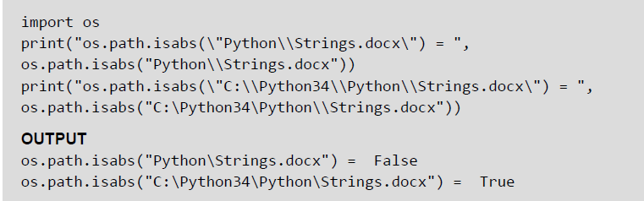
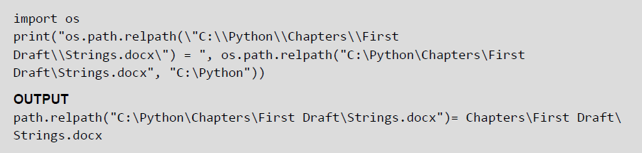
Methods from the os Module — Examples
© Oxford University Press 2017. All rights reserved.

